Slide 1
Governmental Debt and Budget Deficits
M. Finkler
Lecture

Slide 2
Definitions
Deficit = annual spending minus revenues
Primary deficit = annual spending minus revenues minus interest payments
Debt = aggregate amount owed at a point in time
Deficits are a flow measure
Debt is a stock measure
Debt service payments (principal and interest) relative to GDP reflect affordability
Off-budget refers to Social Security and post office cash flows.
Government Sponsored Enterprise cash flow is also off-budget (Freddie, Fanny, & Fed)

Slide 3
Alexander Hamilton on Public Credit – 1990 (page 532 – Mankiw VIII)
“If the maintenance of public credit, then, be truly so important, the next inquiry which suggests itself is: By what means is it to be effected? The ready answer to which question is, by good faith; by punctual performance of contracts. States, like individuals, who observe their engagements are respected and trusted, while the reverse is the fate of those who pursue an opposite conduct.”
Credibility is key, else “faith” or “trust” that lenders can count on being paid in full and in a timely fashion.

Slide 4
CBO Trends
See updated budget provisions – May 2013 www.cbo.gov/publication/44172
Figure 1 – Total Revenue and Outlays
Figure 2 – Federal Debt Held by the Public
Table 1 – Budget Projections and Debt
Figure 3 – Projected Spending by Category
Table 5 – Federal Debt Projected

Slide 5
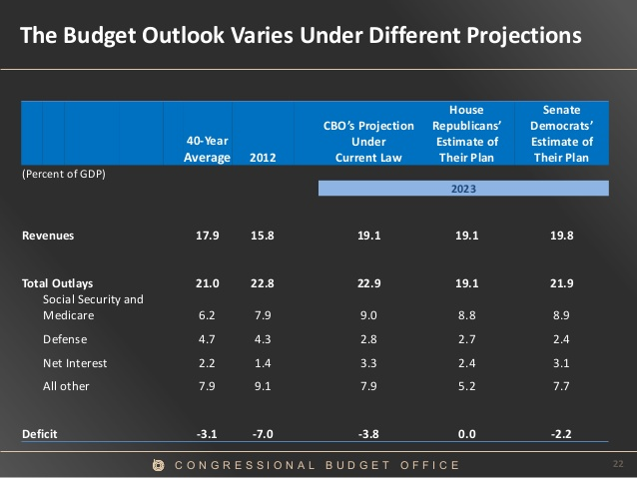

Slide 6
Why worry?
Crowding out of capital investment if saving pays for current expenditures (or previous commitments)
With large fiscal burden, fiscal policy for macro stabilization purposes would be compromised
Increased risk of fiscal crisis (think PIIGS) - credibility
If current laws are modified or not implemented then budget pressures worsen (e.g., Medicare Part B pay)
10 year projections don’t reflect all long term budgetary pressures – especially demographic ones
Capital flight potential

Slide 7
Measurement Problems
How much real debt exists? It depends upon the inflation rate
  D_{t} - π D_{t-1} = additional real debt
Budgets include both capital and operating expenses (not like private or state budgets)
  Highways, bridges, education, and health
Burden relates to (assets – liabilities); hence, some countries (and states) sell off assets to raise funds
Uncounted liabilities – Federal pensions, Social Security and Medicare
Contingent liabilities – Fannie, Freddie, disaster relief, Tarp
See US Debt Clock (www.usdebtclock.org)

Slide 8
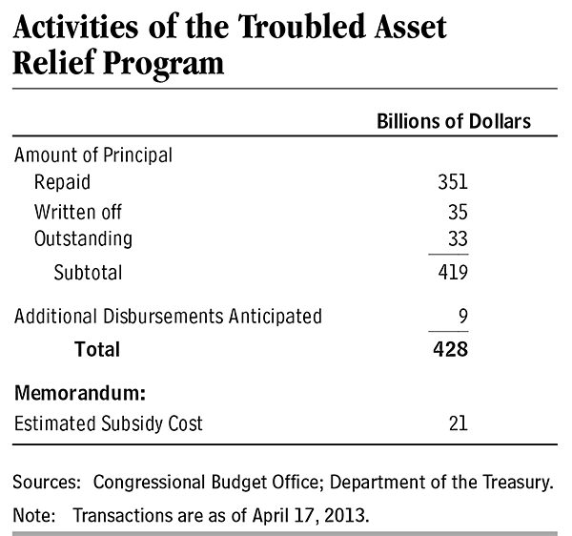
Tarp Accounts - 2013

Slide 9
Who Holds Federal Debt?
Total Debt $16.7 Tr
Intergovernmental Holdings $4.9 Tr
Debt Held by the public $11.9 Tr
Foreign holdings – March 2013
  $5.758Tr (roughly half)
  China $1.25 Tr, Japan $1.10 Tr, Carib Banking Centers $291 B, Oil Exporters $262 B, Brazil $259B
http://www.treasurydirect.gov/NP/debt/current

Slide 10
Who Bears the Burden of Govt. Debt?
Future Generations
  Current bond holders made voluntary purchases
  Benefits accrue to current generation
  Burdens fall on future generations
  Fiscal stimulus generates some short term ↑Y, L
Current Generation – Ricardian View
  Current generation realizes that burden will be shifted onto future generations and expects future tax ↑
  U(C_{today,}C_{retire,}C_{children})
  Much debate about “super rational” view

Slide 11
Balance the Budget
Which one?
  Keynesians argue for balancing the cyclically adjusted budget (i.e., without automatic stabilizers)
    www.cbo.gov/publication/43977
  Prospective or retrospective
  “on budget” vs. “unified budget”
  Accounting tricks push items into different fiscal years.
  “Opt- out” clauses
  Europeans have ignored 3% budget deficit and 60% Debt / GDP for all countries. Even let some countries enter the Eurozone w/o meeting these constraints
  Hamilton “revisited” – that is credible commitments

Slide 12
Constitutional Amendment
Would require that Congress pass a Federal budget that balances projected revenues and expenditures (with limited exceptions)
Proposed 1936, 1979, 1980, 1982, 1985, 1986, 1990, 1992, 1994, 1996, 1997, 2003
Sometimes, it has passed one house (e.g., 1996 – passed house, lost in Senate by 64-35) – requires 2/3rd majority and ¾ of the states

Slide 13
Government Debt vs. Private Debt
Similarities
  Some expenditures generate a stream of future income; so paying out of current income makes little sense
  All debt generates a debt service that must be paid over time
Differences
  Governments have taxing power
  Federal government can print money

